Slide 1
Virtual Doctor: A System for Human Health
Protiva Arafin (18201011)
Mir Arnab Kabir (18201018)
Aiatul Al-Amin Ador(18201019)

Slide 2
Outline:
Project Introduction
Goals & Objective
SDLC & Phases
Requirement Analysis
Feasibility Analysis
Complex Engineering Problem
Design & Diagram
Methodology

Slide 3
Project Introduction:
We had three project proposal which are :
1.Virtual Doctor – A System for Human Health.
2.Football Club Management System
3.PC Configuration System & Tech Portal
Why we choose this Idea?
Health issues are one of the most sensitive things of our life. And our project is very convenient for this matter.Virtual doctor visits are perfectly safe and effective ways to interact with your doctor.virtual visits empower people to confer with their caregivers from the comfort of their own home.This app also assists people to get instant first aid treatment ideas and people can easily get information about nearby hospitals and doctors as per their necessities.In conclude , we can say that this app is systematic and practical for our society.

Slide 4
Main Purpose :
- Help people using Internet and Modern Technology.
- Ensure first aid treatment .
Requirements:
Money , Sponsors & Encouragement

Slide 5
Motivation:
Access to healthcare services is critical to good health, yet rural residents face a variety of access barriers. Rural residents often encounter barriers to healthcare that limit their ability to obtain the care they need.And we know that first aid knowledge is invaluable for both individual and for our community.First Aid treatment can help to save lives. It allows the rescuer to provide the victim comfort, gives us tools to prevent the situation from becoming worse.But we all don’t have these kind of knowledge. Another problem is- Accidents can happen anytime. Then we need Emergency medical services (EMS).In that situation, we need emergency transportation and also the location of nearby hospital for getting emergency medical services.
So, we are going to build an app-based system and this app will cover all those problems’ solution that mentioned above.

Slide 6
Goals & Objective:
· User friendly service.
· Provide first-aid treatment.
· Contract with specialist doctor through our system.
· Provide Hospital suggestion and Ambulance in serious case.
· Keep all treatment data without patient’s information.
· Analyze stored data and using that data to create and improve
· Provide treatment data to pharmaceutical company for understand the treatment process and create medicines.

Slide 7
SDLC & Phases:
Systems Development Life Cycle is a systematic approach which explicitly breaks down the work into phases that are required to implement either new or modified Information System.
SDLC is used by analysts to develop an information system. SDLC includes the following activities −
Planning
Information Requirements
Analyzing
Designing
Deployment
Maintenance

Slide 8
Analyzing Requirements:
The main aim of this phase is to collect the details of each requirement of the customers so that the developers will clearly understand what they are developing. And determining whether the stated requirements are unclear, incomplete, ambiguous, or contradictory, and then resolving these issues.
User Requirements:
1.People never know when any injury may happen to them. Thus it is always good to have emergency backup. They need immediate first aid treatment.
2.If first aid treatment doesn’t work then people need instant information about nearby hospitals.
3.Sometimes transportation is a huge problem in our country. So they need ambulance without any delay
4.Organized information is the best thing to find out something instantly. People need the best doctor available in their area for their specific problems.

Slide 9
Feasibility Analysis:
It is one of the major Phase of SDLC in which an organization discusses about the cost and benefits of the software or System. It's also call decision making phase. Because profit from the system plays an important role if cost is very high then the company may face less.
After the feasibility Studies-
I. The project may be accepted with some modification.
II. Rejected

Slide 10
Technical Feasibility Analysis:
A technical feasibility study assesses the details of how we intend to deliver a product or service to customers.
Source Of Risk:
1.Users have a lack of familiarity with our system?
2.Whether the treatment that doctors will give to patients will be right?
3.Will user data safe with us?

Slide 11
Organizational Feasibility:
Organizational feasibility shows that how well the system ultimately will be accepted by its users and incorporated into the ongoing operations of the organization.
If we will build it will they come?
1.Our system will be one of the most efficient system available on the market.
2.People from remote areas will be able to get the essential service at home without coming to the city at low costs.

Slide 12
Economic Feasibility:
Economic feasibility is determined by identifying costs and benefits associated with the system, assigning values to them, calculating future cash flows, ROI, BEP and measuring the financial worthiness of the project. There is two method to do that.
For our system, We will use Simple Cash Flow Method.

Slide 13
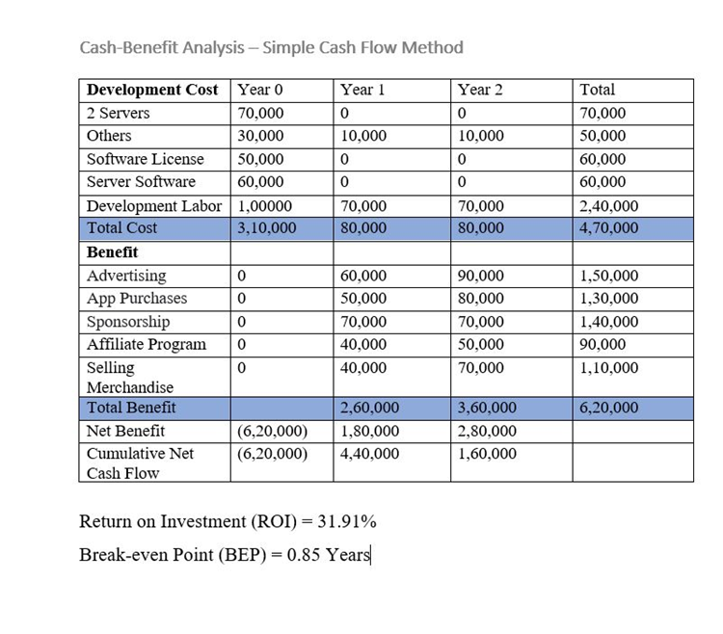
From, This analysis,
•Acceptable ROI
•Benefit starts from the First year.
So, Economically Acceptable Project.

Slide 14
Complex Engineering Problem Addressing
Objective: The objective of the project is to use a real time data-based AI technology to solve the problem.
Critical Challenges: Working with hospitals stuffs, medicine company and doctors will be a critical challenge.
Conflicting Requirements: Without seeing the patient, prescribe a prescription will be a risk for doctors. Or they may think like that. Maybe they will hesitate to work. So, Doctors will a conflicting Challenge.

Slide 15
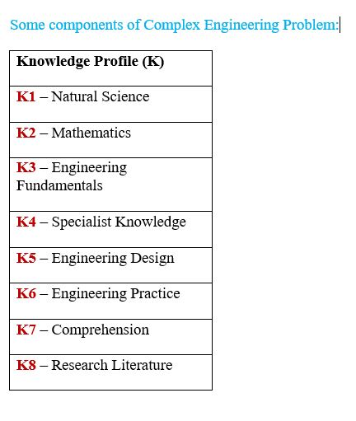
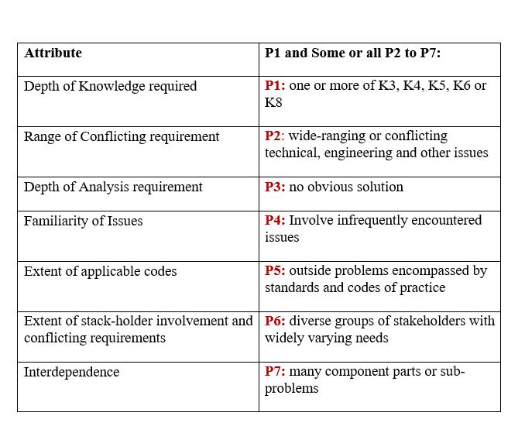
Complex Engineering Problem Addressing

Slide 16
Complex Engineering Problem Addressing
Let’s explore how a few P’s could be addressed through this project:
P1(Depth of Knowledge required- one or more of K3, K4, K5, K6 or K8): Develop an App for this project (K6 – Engineering Practice), This project generally requires a study of similar work with the same purpose as ours (K8 – Research Literature), We must need some medical knowledge and hospital and doctor things (K4 – Specialist Knowledge), Design the program (K3 – Engineering Fundamentals), data related study and find a solution for a specific problem (K2 – Mathematics)
P2(Range of Conflicting requirement- wide-ranging or conflicting technical, engineering and other issues): Data Analysis with proper regularization while limited real data is available will be create a Conflict for this project.
P6(Extent of stakeholder involvement and conflicting requirements- diverse groups of stakeholders with widely varying needs): Various group of stakeholders also the hospital and medicine stores can be benefited by this project.
P7(Interdependence- many component parts or sub-problems): This project involves four subsystems mainly:
· Data Collection
· Data Analysis
· Application Model
· Machine Learning

Slide 17
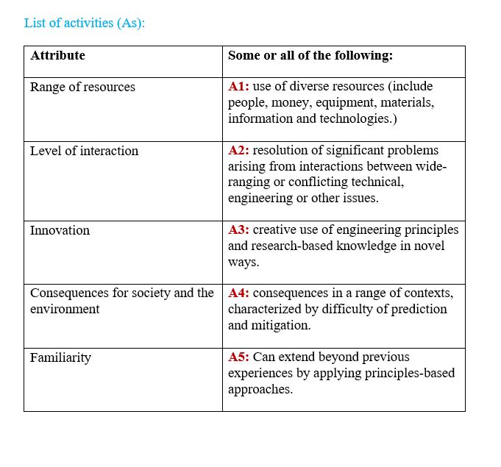
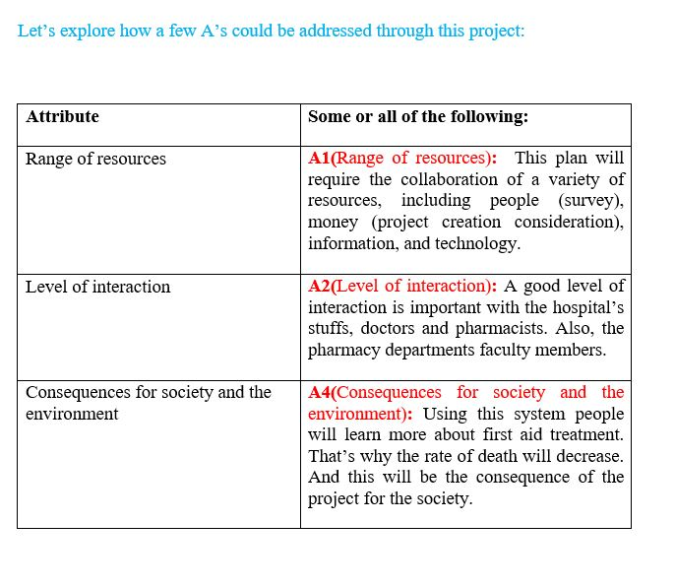
Complex Engineering Problem Addressing

Slide 18
Design & Diagram:
During the design phase, developers and technical architects start the high-level design of the software and system to be able to deliver each requirement.
For this project, we are using –
· System Diagram
· Data-Flow Diagram
· Entity-Relationship Diagram
· Use-Case Diagram
· UML Class Diagram

Slide 19
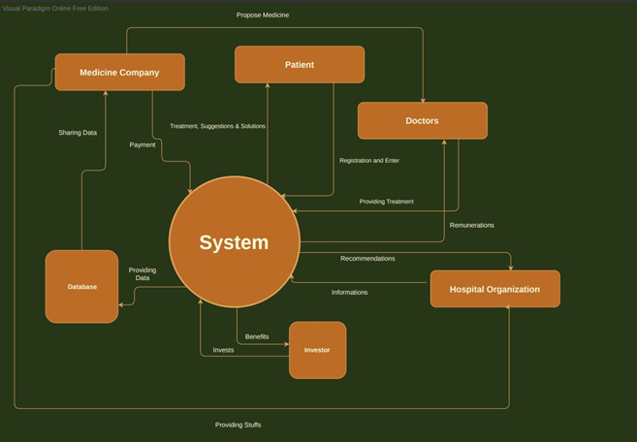
System Diagram:

Slide 20
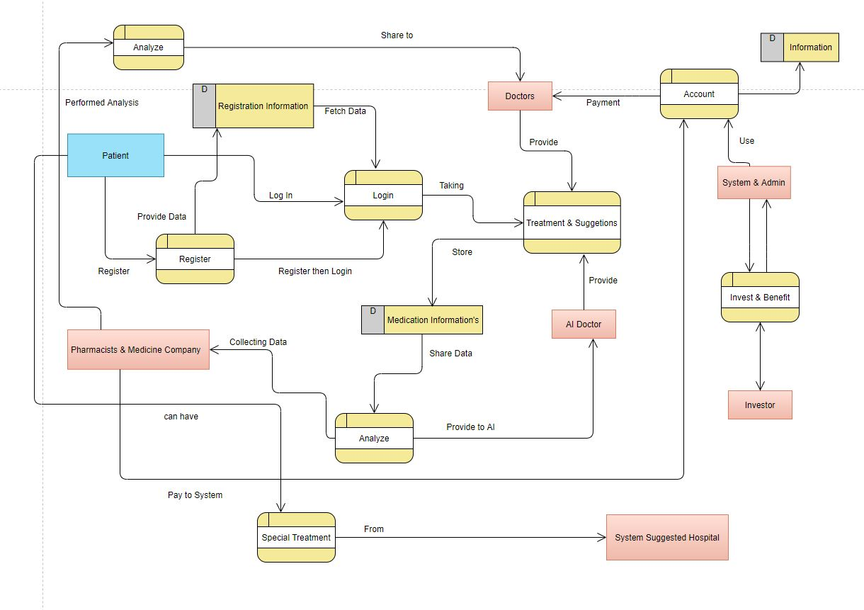
Data-Flow Diagram:

Slide 21
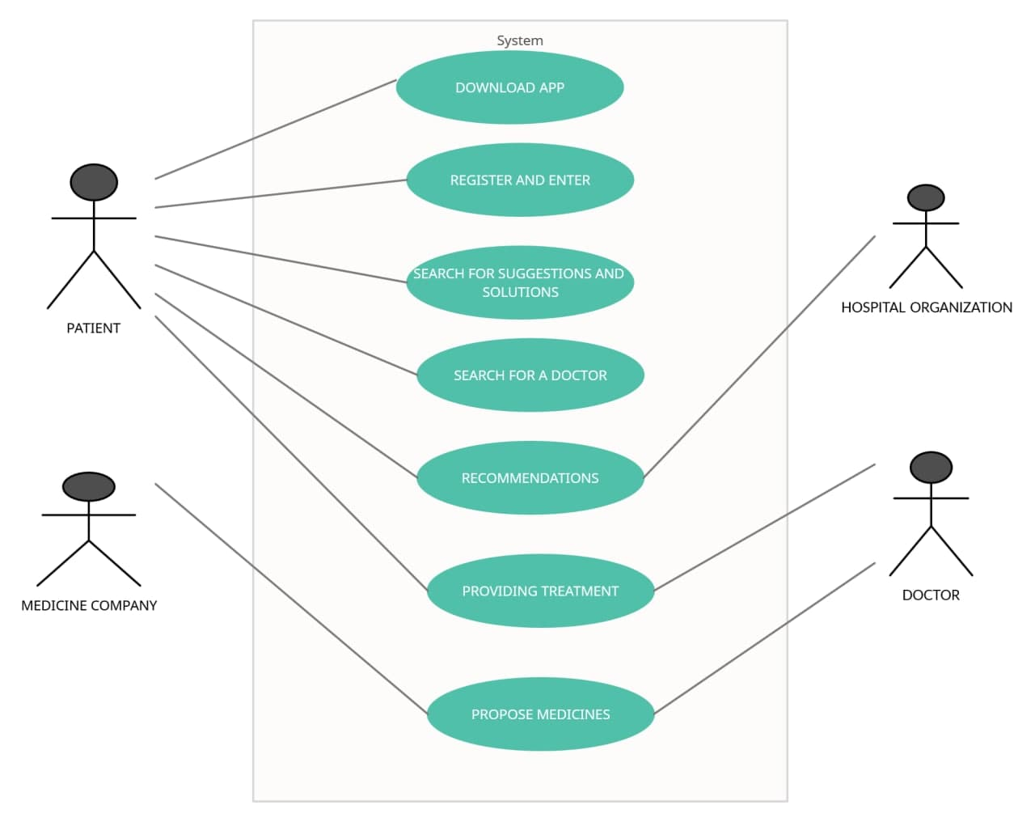
Use-Case Diagram:

Slide 22
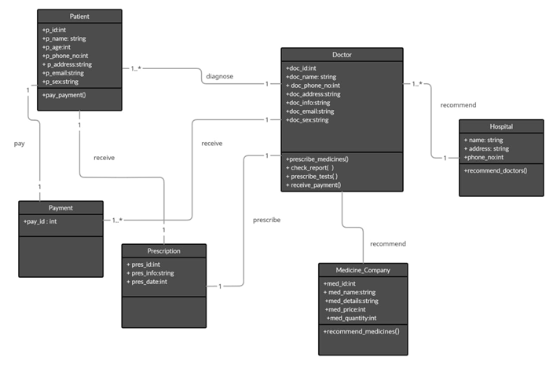
UML Class Diagram:

Slide 23
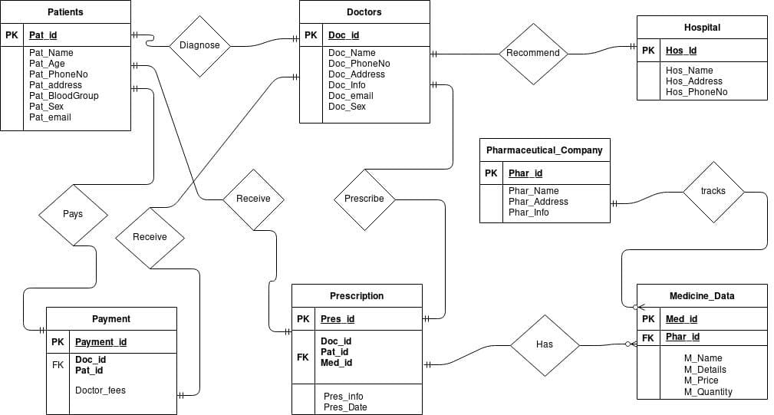
Entity-Relationship Diagram:

Slide 24
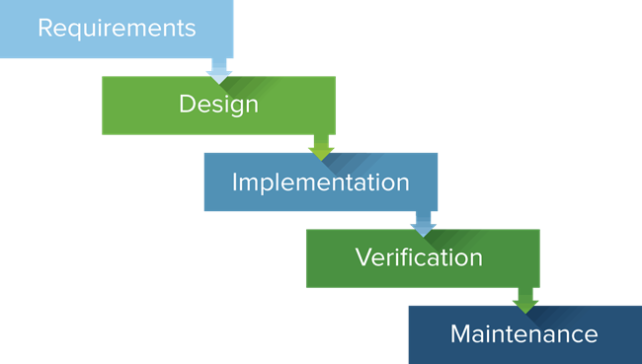
Methodology:
The Software Development Life Cycle (SDLC) refers to a methodology with clearly defined processes for creating high-quality software.
For this project, we are using Waterfall Methodology.

